Slide 1
Hamiltonian Path and Cycle

Slide 2
Hamiltonian Circuit/Paths:
A Hamiltonian path in a graph is a path that passes through every vertex in the graph exactly once. A Hamiltonian path does not necessarily pass through all the edges of the graph.
However,
A Hamiltonian path which ends in the same place in which it began is called a Hamiltonian circuit.

Slide 3
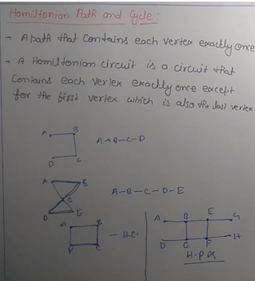

Slide 4
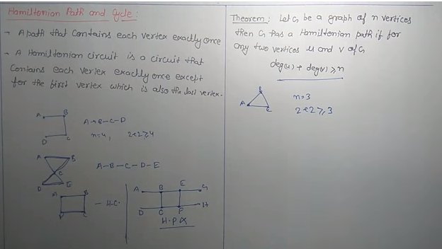

Slide 5

Trace a Hamiltonian path
Only a path, not a circuit. The path did not end at the same vertex it started.
The path does not need to go over every edge but it can only go over an edge once and must pass through every vertex exactly once.
Hamiltonian Circuits are often called the mail man circuit because the mailman goes to every mailbox but does not need to go over every street.

Slide 6
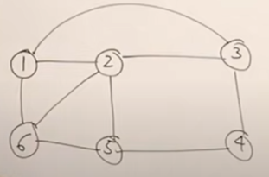

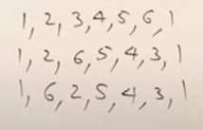
Hamiltonian Cycle Problem
Output :
All possible Hamiltonian Cycles
and so on…

Slide 7
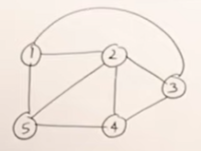
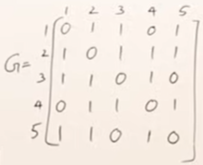

Hamiltonian Cycle Problem
Given Graph
Adjacency Matrix
Path vector

Slide 8
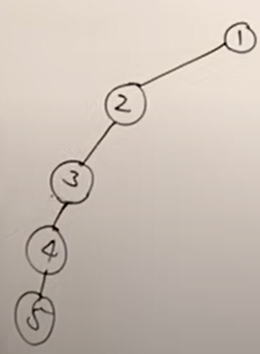
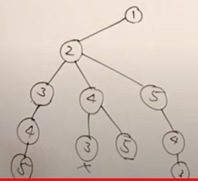
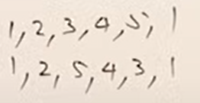
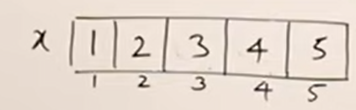
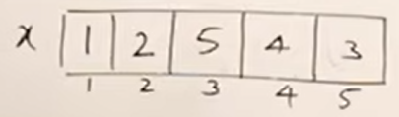
Hamiltonian Cycle : Solution using Backtracking
State Space Tree 1
State Space Tree 2
Two Hamiltonian Cycles so far…
More can be generated and so on…
Path Vector 2
Path Vector 1

Slide 9
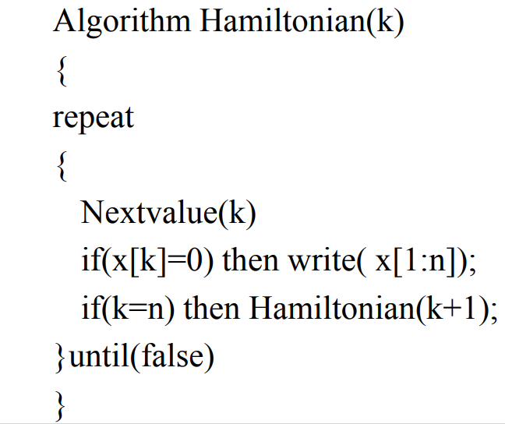
Hamiltonian Cycle : Algorithm
This is main algorithm, which calls Nextvalue(k) to find next vertex

Slide 10
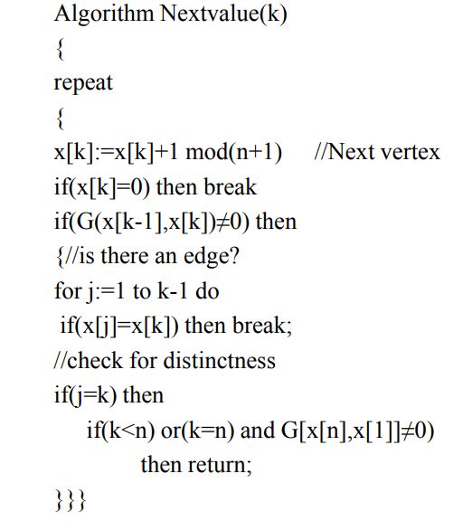
Nextvalue Algorithm
This algorithm find next vertex and check it should not be present already in path, and there should be an edge for the next vertex from the previous one.

